Slide 1
Computer vision and deep learning
Lecture 2

Slide 2

Image classification I
Classifier
CAT*
* assuming that we have a set of labels L = {cat, dog, ship …}
Image source: https://katzenworld.co.uk/2019/06/30/mews-funny-cat-picture-collection/

Slide 3
Image classification II
Unlike other computer science problems:
Find the maximum value in an array
Sort an array
Find the shortest distance between two nodes in a graph
No obvious way to implement an algorithm for image classification
def image_classifier(image):
# ???
return class_label

Slide 4
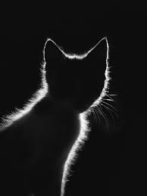
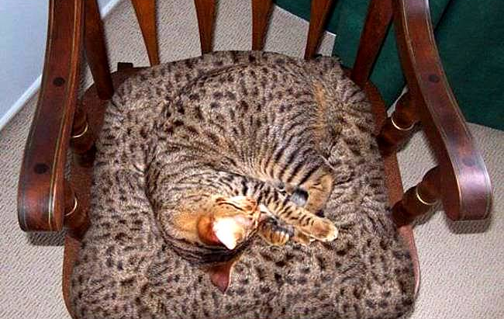
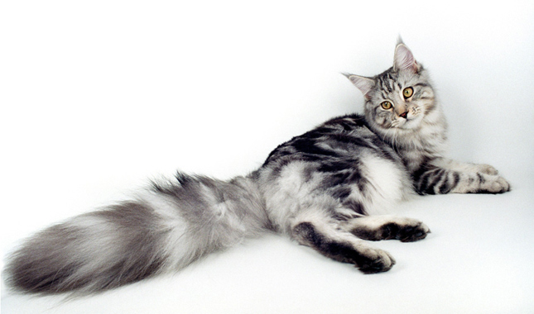

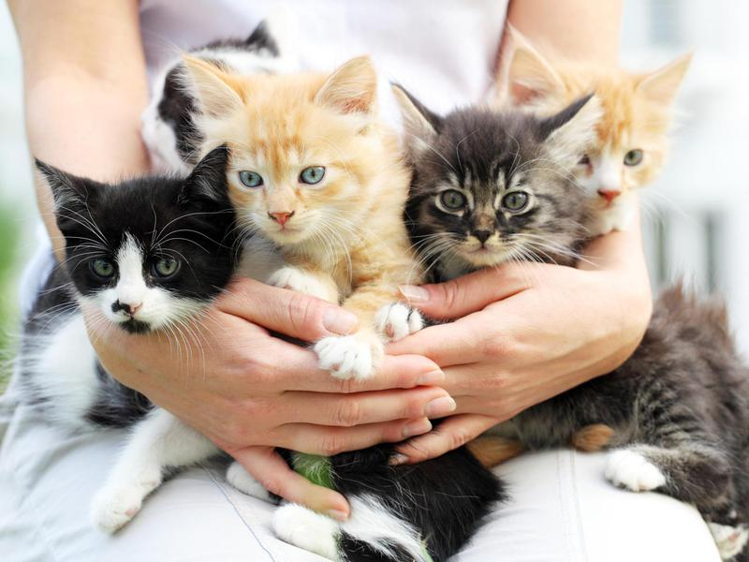
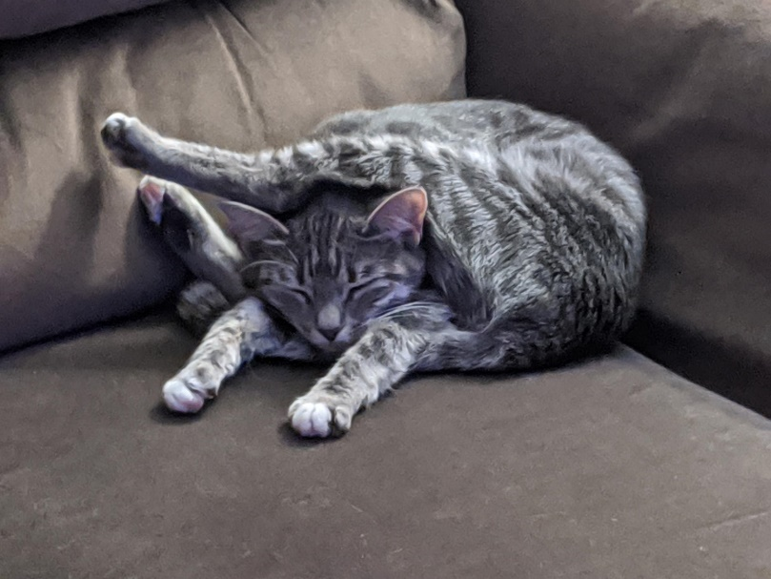

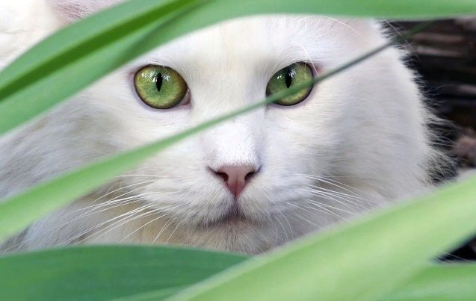
Classification challenges
View point variations
Occlusions
Scale variation
Deformation
Lightning conditions
Background clutter
Intra-class variation

Slide 5
Linear classification

Slide 6






Image representation
blue
w
green
red
h
h
w
Flatten the image to a 1D array
 |  |  |  | ……
w*h*3 values between [0, 255]

Slide 7

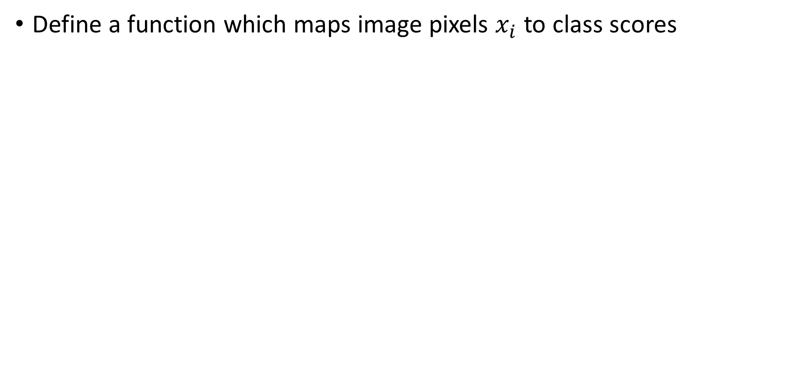
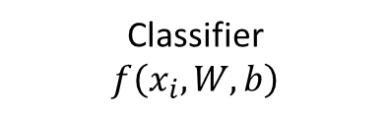
Linear classification
Define a function which maps image pixels $x_{i}$ to class scores
$${f\left(x_{i},W, b\right)=x_{i}⋅W}^{ }+b$$
weights
bias
Classifier
$$f\left(x_{i},W, b\right)$$
N class scores

Slide 8
Linear classification
CIFAR 10 example:
3 channel images, 32x32 pixels
N = 10 class scores
x_{i} ∈ ℝ^{D}
f: ℝ^{D} → ℝ^{N}
$${, f\left(x_{i},W, b\right)= x_{i}⋅W+b}^{ }$$
Classifier
$$f\left(x_{i},W, b\right)$$
N class scores
N = 10
D = 32x32x3 = 3072

Slide 9
Linear classification
CIFAR 10 example:
3 channel images, 32x32 pixels, x_{i} size [1 x 3072]
N = 10 class scores
x_{i} ∈ ℝ^{D}
[1 x D]
$${f\left(x_{i},W, b\right)= }^{ }x_{i}⋅W+b$$
f: ℝ^{D} → ℝ^{N}
[1 x 3072 ]
Classifier
$$f\left(x_{i},W, b\right)$$
N class scores
N = 10
D = 32x32x3 = 3072

Slide 10
Linear classification
CIFAR 10 example:
3 channel images, 32x32 pixels
N = 10 class scores
x_{i} ∈ ℝ^{D}
[1 x D]
size: D x N
$${f\left(x_{i},W, b\right)=x_{i }⋅W}^{ }+b$$
f: ℝ^{D} → ℝ^{N}
[1 x 3072]
3072 x 10
Classifier
$$f\left(x_{i},W, b\right)$$
N class scores
N = 10
D = 32x32x3 = 3072

Slide 11
Linear classification
CIFAR 10 example:
3 channel images, 32x32 pixels
N = 10 class scores
x_{i} ∈ ℝ^{D}
[1 x D]
size: D x N
size: 1 x N
$${f\left(x_{i},W, b\right)=x_{i }⋅W}^{ }+b$$
f: ℝ^{D} → ℝ^{N}
1 x N
[1 x 3072]
3072 x 10
Classifier
$$f\left(x_{i},W, b\right)$$
N class scores
N = 10
D = 32x32x3 = 3072

Slide 12


Linear classification - simplified example
weights W
0.7 | -0.3 | 0
-0.3 | 0.5 | 0.25
2.5 | 3.1 | 0.4
1 | -3 | 0.1
X
bias b
57 | 77 | 200 | 128
·
+
1.7 | -2 | 3
=
646.5 | 255.4 | 115.05
cat score
boat score
shark score
57 | 77
200 | 128
Example adapted from: https://cs231n.github.io/

Slide 13
Linear classification - simplified example
57 | 77
200 | 128
0.7 | -0.3 | 2.5 | 1
-0.3 | 0.5 | 3.1 | -3
0 | 0.25 | 0.4 | 0.1
0.7 | -0.3
2.5 | 1
-0.3 | 0.5
3.1 | -3
0 57 | 0.25
0.4 | 0.14
W
1.7
-2
3
b
score
646.5
255.4
115.05
Example adapted from: https://cs231n.github.io/

Slide 14
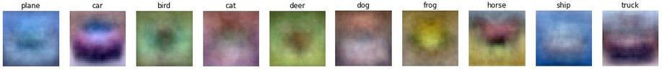
Linear classification – visual interpretation
Linear classification can be seen as a template matching process, where the weights are learned
Each row of the weights matrix is a prototype (template) for one of the classes
Image source: https://cs231n.github.io/

Slide 15
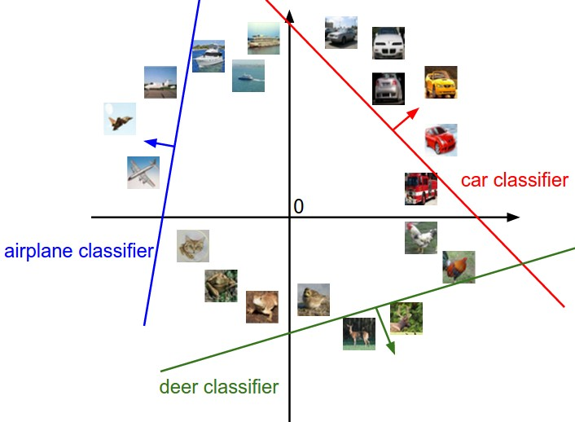
Linear classification – geometric interpretation
Hyper-plane cutting up the space
Image source: https://cs231n.github.io/

Slide 16
Linear classification – implementation hints The bias trick
weights W
0.7 | -0.3 | 0
-0.3 | 0.5 | 0.25
2.5 | 3.1 | 0.4
1 | -3 | 0.1
X
bias b
57 | 77 | 200 | 128
·
+
1.7 | -2 | 3
=
646.5 | 255.4 | 115.05
cat score
boat score
shark score
57 | 77
200 | 128
Example adapted from: https://cs231n.github.io/

Slide 17
Linear classification – implementation hints The bias trick
weights W
0.7 | -0.3 | 0
-0.3 | 0.5 | 0.25
2.5 | 3.1 | 0.4
1 | -3 | 0.1
1.7 | -2 | 3
X
57 | 77 | 200 | 128 | 1
·
=
646.5 | 255.4 | 115.05
cat score
boat score
shark score
bias b
57 | 77
200 | 128
Example adapted from: https://cs231n.github.io/

Slide 18
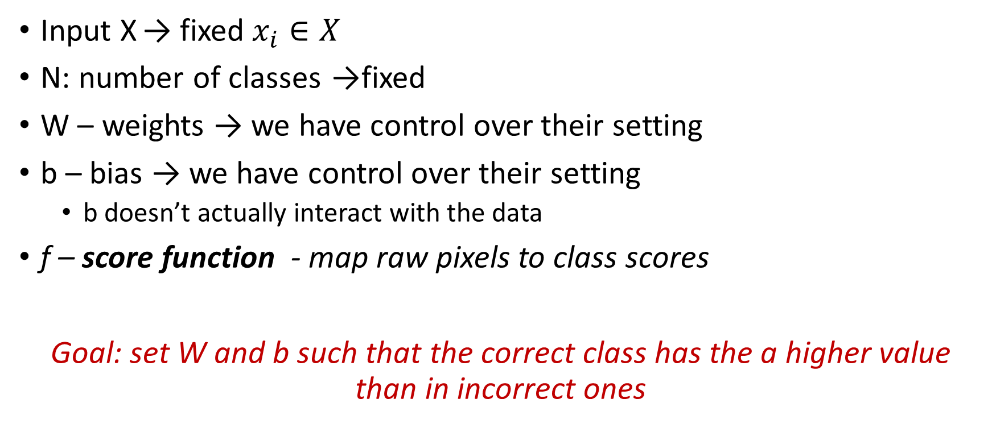
Linear classification
$${f\left(X,W, b\right)= }^{ }X⋅W+b$$
Input X → fixed $x_{i}∈X$
N: number of classes →fixed
W – weights → we have control over their setting
b – bias → we have control over their setting
b doesn’t actually interact with the data
f – score function - map raw pixels to class scores
Goal: set W and b such that the correct class has the a higher value than in incorrect ones

Slide 19
Next steps
Define a loss function L
L - measures the quality of W and b based on how well the predicted scores agree with the ground truth labels
L – how happy are we with the scores across the training data? How good is our (current) classifier?
Find an efficient way to determine the parameters (W and b) such that the loss function is minimized

Slide 20
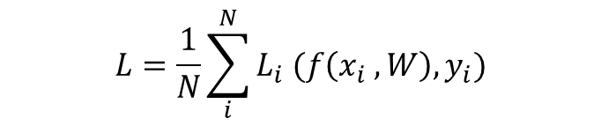
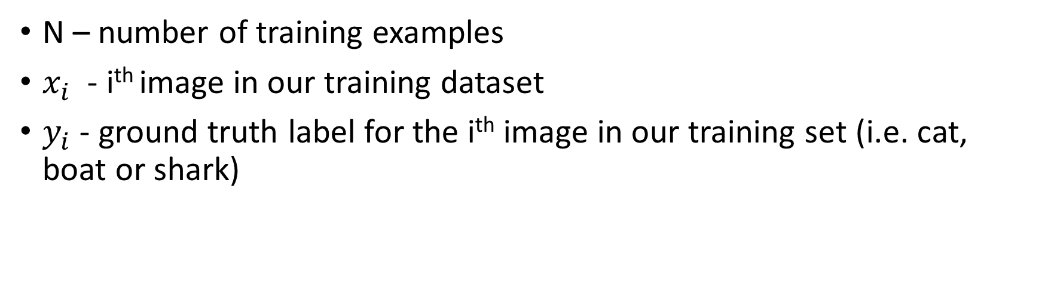
Loss function
$$L=\frac{1}{N}\sum_{i}^{N}{L_{i} (f\left(x_{i} , W\right), y_{i})}$$
N – number of training examples
$x_{i}$ - i^{th} image in our training dataset
$y_{i}$ - ground truth label for the i^{th} image in our training set (i.e. cat, boat or shark)

Slide 21
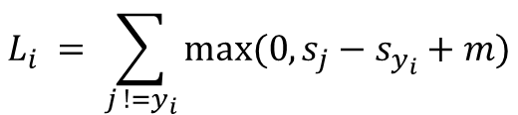
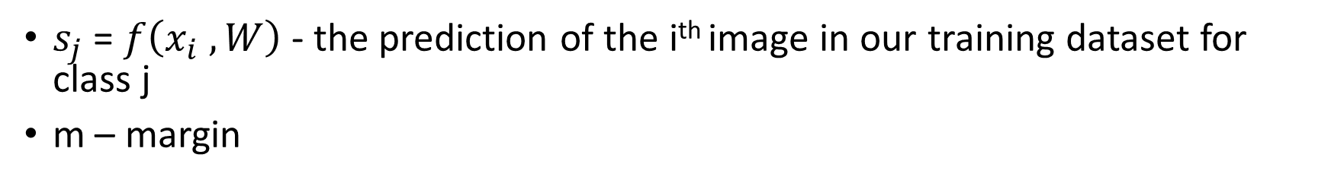
Example – hinge loss or SVM loss
$s_{j}$ = $f\left(x_{i} , W\right)$ - the prediction of the i^{th} image in our training dataset for class j
m – margin
$${L_{i}}_{ }= \sum_{j !=y_{i}}^{ }{max⁡(0, s_{j}−s_{y_{i}}+m)}$$

Slide 22
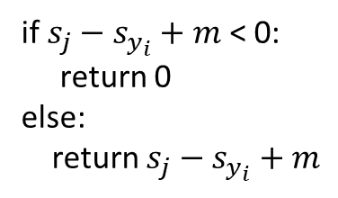
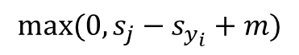
Example – hinge loss or SVM loss
$s_{j}$ = $f\left(x_{i} , W\right)$ - the prediction of the i^{th} image in our training dataset for class j
m – margin
$$max⁡(0, s_{j}−s_{y_{i}}+m)$$
$${L_{i}}_{ }= \sum_{j !=y_{i}}^{ }{max⁡(0, s_{j}−s_{y_{i}}+m)}$$
if $s_{j}−s_{y_{i}}+m$ < 0:
return 0
else:
return $s_{j}−s_{y_{i}}+m$

Slide 23
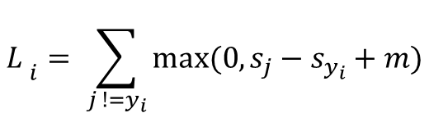
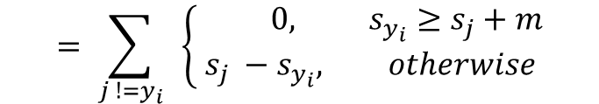
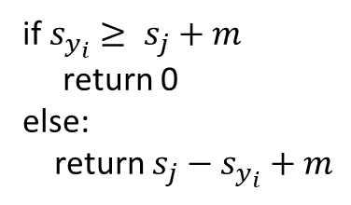
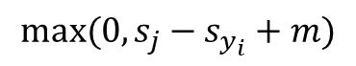
Example – hinge loss
$s_{j}$ = $f\left(x_{i} , W\right)$ - the prediction of the i^{th} image in our training dataset for class j
m – margin
$$max⁡(0, s_{j}−s_{y_{i}}+m)$$
$${L_{ }}_{i}= \sum_{j !=y_{i}}{max⁡(0, s_{j}−s_{y_{i}}+m)}$$
if $s_{y_{i}}≥ s_{j}+m$
return 0
else:
return $s_{j}−s_{y_{i}}+m$
$$= \sum_{j !=y_{i}}{ }\left\{\begin{aligned} 0, s_{y_{i}}≥s_{j}+m \\ &s_{j} −s_{y_{i}}, otherwise\end{aligned}\right.$$

Slide 24
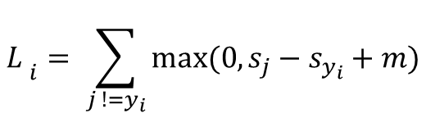
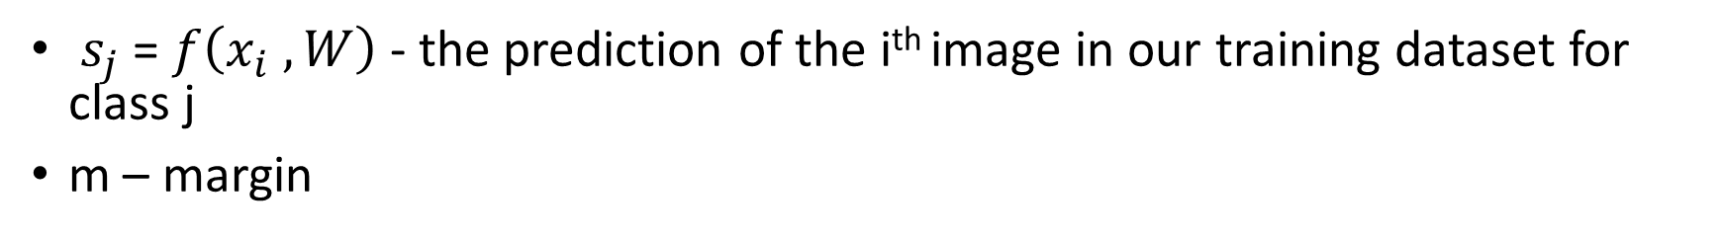
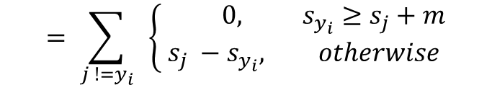
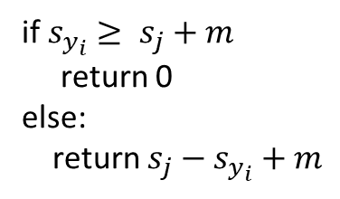
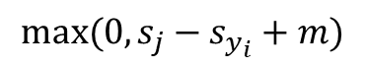
Example – hinge loss
$s_{j}$ = $f\left(x_{i} , W\right)$ - the prediction of the i^{th} image in our training dataset for class j
m – margin
$$max⁡(0, s_{j}−s_{y_{i}}+m)$$
$${L_{ }}_{i}= \sum_{j !=y_{i}}{max⁡(0, s_{j}−s_{y_{i}}+m)}$$
if $s_{y_{i}}≥ s_{j}+m$
return 0
else:
return $s_{j}−s_{y_{i}}+m$
$$= \sum_{j !=y_{i}}{ }\left\{\begin{aligned} 0, s_{y_{i}}≥s_{j}+m \\ &s_{j} −s_{y_{i}}, otherwise\end{aligned}\right.$$
Intuition: we are “happy” if the score of the correct class if larger, by a margin of at least m, than the score of the other classes

Slide 25
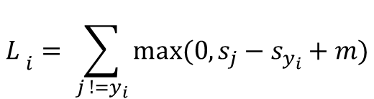
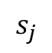
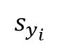
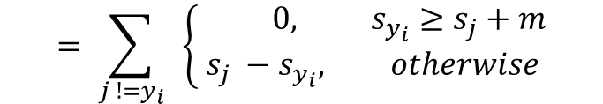
Example – hinge loss
$s_{j}$ = $f\left(x_{i} , W\right)$ - the prediction of the i^{th} image in our training dataset for class j
m – margin
$${L_{ }}_{i}= \sum_{j !=y_{i}}{max⁡(0, s_{j}−s_{y_{i}}+m)}$$
loss
$$= \sum_{j !=y_{i}}{ }\left\{\begin{aligned} 0, s_{y_{i}}≥s_{j}+m \\ &s_{j} −s_{y_{i}}, otherwise\end{aligned}\right.$$
$$s_{j}$$
$$s_{y_{i}}$$
m

Slide 26
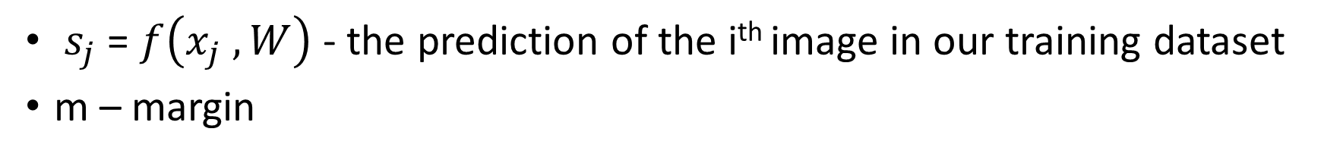
Example – hinge loss
$s_{j}$ = $f\left(x_{j} , W\right)$ - the prediction of the i^{th} image in our training dataset
m – margin
$${L_{ }}_{i}= \sum_{j !=y_{i}}{max⁡(0, s_{j}−s_{y_{i}}+m)}$$
loss
$$= \sum_{j !=y_{i}}{ }\left\{\begin{aligned} 0, s_{y_{i}}≥s_{j}+m \\ &s_{j} −s_{y_{i}}, otherwise\end{aligned}\right.$$
$$s_{j}$$
$$s_{y_{i}}$$
m

Slide 27

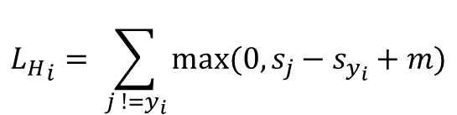
Example – hinge loss
$${L_{H}}_{i}= \sum_{j !=y_{i}}{max⁡(0, s_{j}−s_{y_{i}}+m)}$$
Let’s set m = 1
For image 1
=max(0, - 5 – 3.2 + 1) + max(0, 10 – 3.2 + 1)
= 0 + 7.8
= 7.8

Slide 28
Example – hinge loss
$${L_{H}}_{i}= \sum_{j !=y_{i}}{max⁡(0, s_{j}−s_{y_{i}}+m)}$$
Let’s set m = 1
For image 1
=max(0, - 5 – 3.2 + 1) + max(0, 10 – 3.2 + 1)
= 0 + 7.8
= 7.8

Slide 29
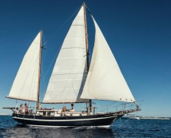
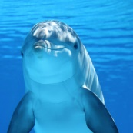
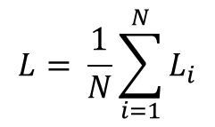
Example – hinge loss
$${L_{H}}_{i}= \sum_{j !=y_{i}}{max⁡(0, s_{j}−s_{y_{i}}+m)}$$
Let’s set m = 1
For image 2
= max(0, 0.1 – 14 + 1) + max(0, 5 – 14 + 1)
= 0 + 0
= 0
Total loss L
$$L= \frac{1}{N}\sum_{i=1}^{N}{L_{i}}$$
For image 3
= max(0, 0.3 – 14 + 1 ) + max(0, 8 – 14 + 1)
= 0 + 0
= 0
L = (7.8 + 0 + 0 )/3 = 2.6

Slide 30
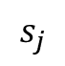
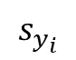
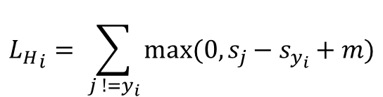
Hinge loss
$${L_{H}}_{i}= \sum_{j !=y_{i}}{max⁡(0, s_{j}−s_{y_{i}}+m)}$$
What is the min value and the max value of hinge loss?
loss
$$s_{j}$$
$$s_{y_{i}}$$

Slide 31
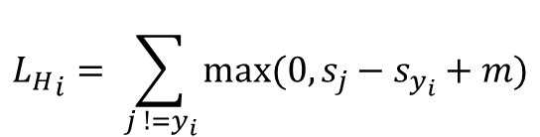
Hinge loss
$${L_{H}}_{i}= \sum_{j !=y_{i}}{max⁡(0, s_{j}−s_{y_{i}}+m)}$$
What is the min value and the max value of hinge loss?
min is 0: the correct score is much larger (>=m ) than the incorrect scores
max is infinity
In the beginning of the training (W ≈ 0) so all scores ≈ 0. What is the value of L ?
loss
$$s_{j}$$
$$s_{y_{i}}$$

Slide 32
Hinge loss
$${L_{H}}_{i}= \sum_{j !=y_{i}}{max⁡(0, s_{j}−s_{y_{i}}+m)}$$
What is the min value and the max value of hinge loss?
In the beginning of the training (W ≈ 0) so all scores ≈ 0. What is the value of L ?
N – 1
loss
$$s_{j}$$
$$s_{y_{i}}$$

Slide 33
Regularization
Suppose that you found some values for the parameters W such that the loss function is 0. Do you think there is a single setting for the parameters W, such that the loss is 0?

Slide 34
Regularization
Suppose that you found some values for the parameters W such that the loss function is 0. Do you think there is a single setting for the parameters W, such that the loss is 0?
W, 2W, 3W, αW
extend the loss function with a regularization penalty to discourage large weights

Slide 35


Regularization
Regularization loss
$$L= \frac{1}{N}\sum_{i=1}^{N}{L_{i}}+λR(W)$$
Data loss
Prevent overfitting (the model will perform ”too” well on the training data)
Make the model simpler
Occam’s razor: "the simplest explanation is most likely the right one"
Image source: https://ro.pinterest.com/pin/192669690286459858/?nic_v2=1a57hjLPe

Slide 36
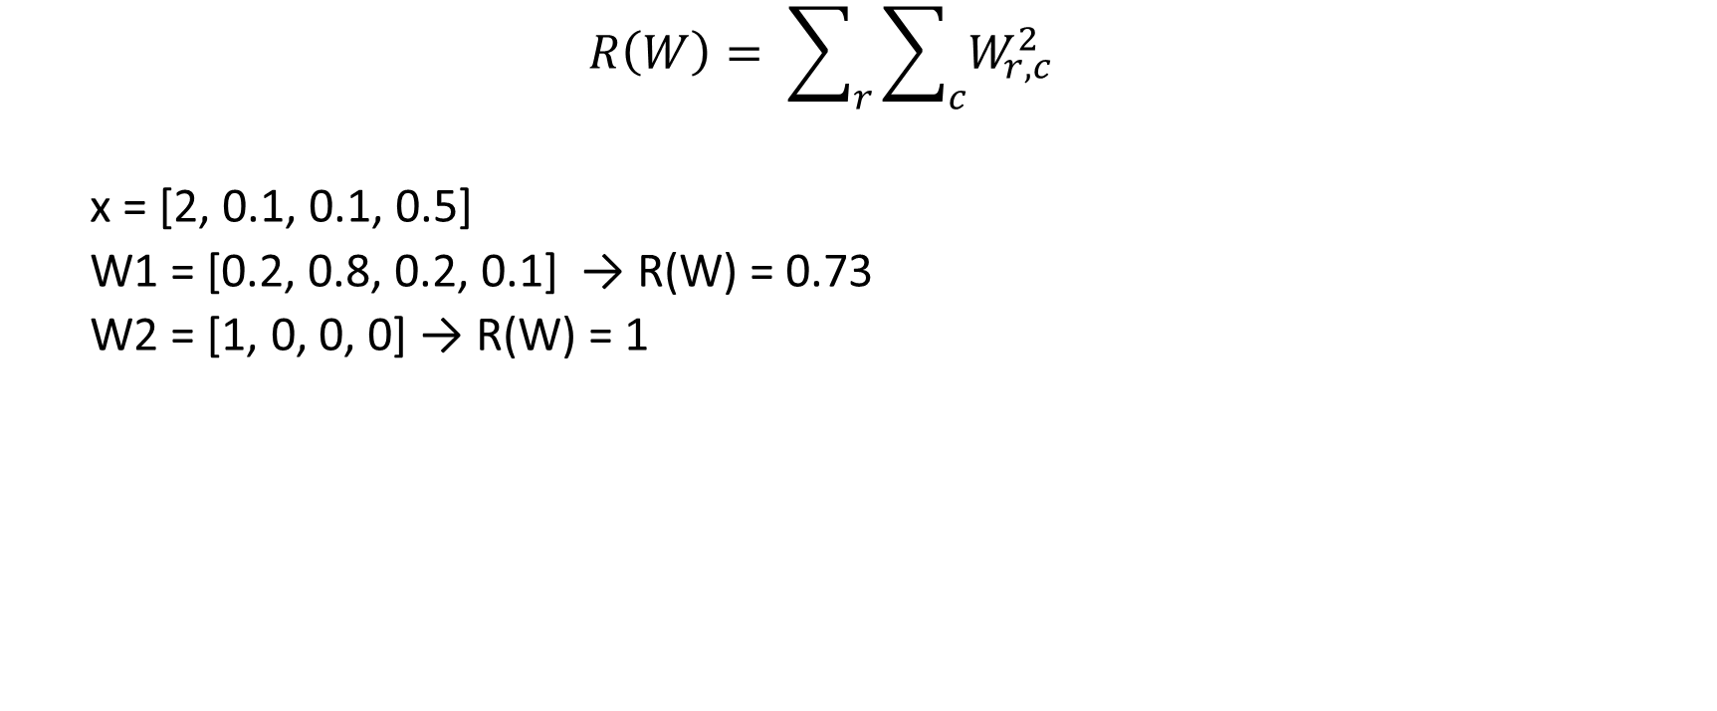
Regularization L2 regularization
$$R\left(W\right)= \sum_{r}{\sum_{c}{W_{r,c}^{2}}}$$
x = [2, 0.1, 0.1, 0.5]
W1 = [0.2, 0.8, 0.2, 0.1] → R(W) = 0.73
W2 = [1, 0, 0, 0] → R(W) = 1
W1· X = 2
W2· X = 2

Slide 37
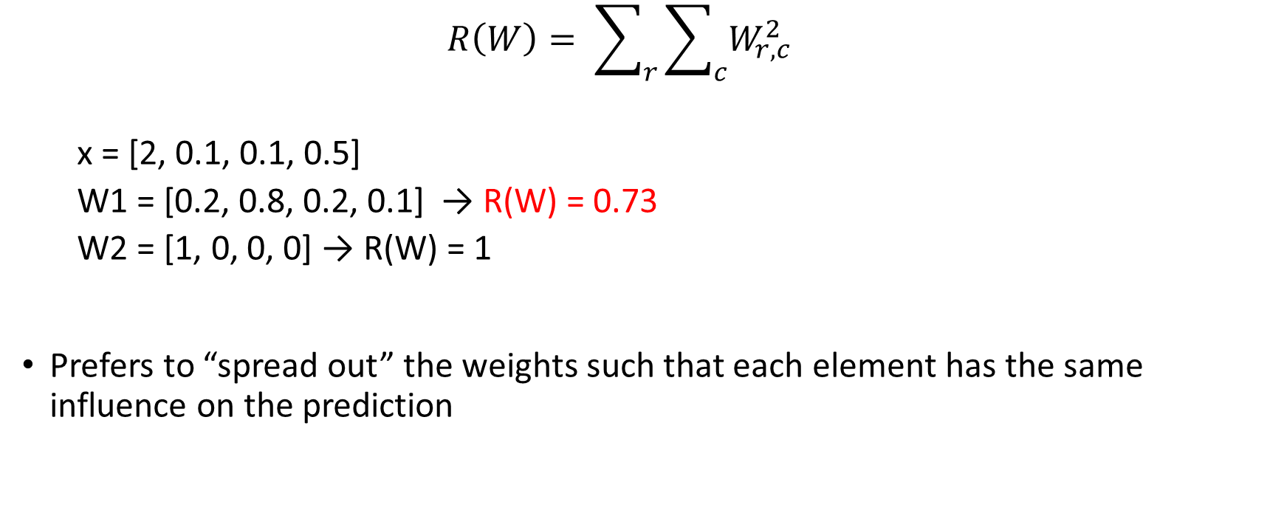
Regularization L2 regularization
$$R\left(W\right)= \sum_{r}{\sum_{c}{W_{r,c}^{2}}}$$
x = [2, 0.1, 0.1, 0.5]
W1 = [0.2, 0.8, 0.2, 0.1] → R(W) = 0.73
W2 = [1, 0, 0, 0] → R(W) = 1
Prefers to “spread out” the weights such that each element has the same influence on the prediction
W1· X = 2
W2· X = 2

Slide 38
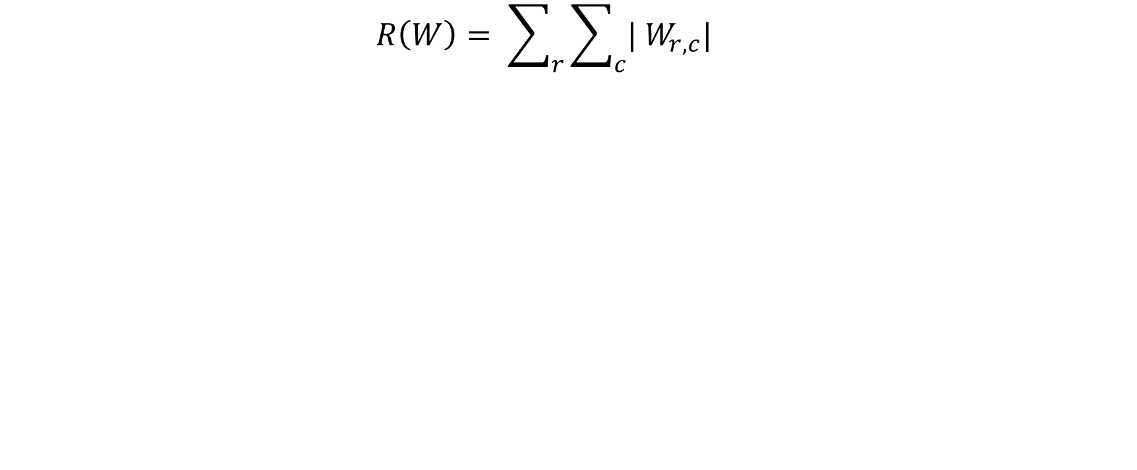
Regularization L1 regularization
$$R\left(W\right)= \sum_{r}{\sum_{c}{{| W}_{r,c}^{}|}}$$
x = [2, 0.1, 0.1, 0.5]
W1 = [0.2, 0.8, 0.2, 0.1] → R(W) = 1.4
W2 = [1, 0, 0, 0] → R(W) = 1
W1· X = 2
W2· X = 2

Slide 39
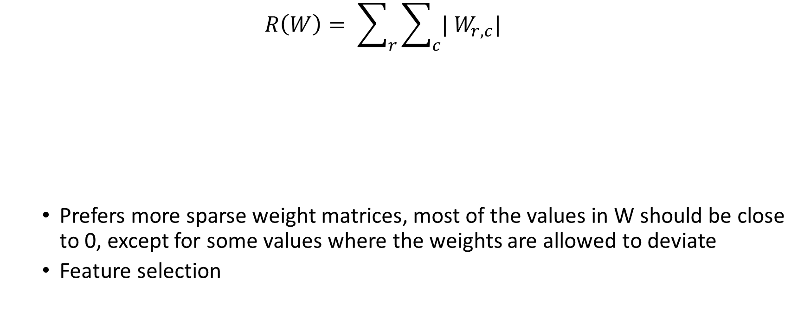
Regularization L1 regularization
$$R\left(W\right)= \sum_{r}{\sum_{c}{{| W}_{r,c}^{}|}}$$
Prefers more sparse weight matrices, most of the values in W should be close to 0, except for some values where the weights are allowed to deviate
Feature selection
x = [2, 0.1, 0.1, 0.5]
W1 = [0.2, 0.8, 0.2, 0.1] → R(W) = 1.4
W2 = [1, 0, 0, 0] → R(W) = 1
W1· X = 2
W2· X = 2

Slide 40
Example – softmax classifier
So far, we don’t have interpretation for the outputs of the score function
What if we would like to determine the probability of each class?

Slide 41
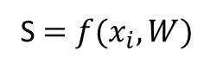
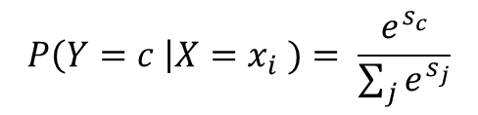
Example – softmax classifier
So far, we don’t have interpretation for the outputs of the score function
What if we would like to determine the probability of each class?
Softmax function
S $=f(x_{i}, W)$
$$P\left(Y=c \right|X=x_{i} )= \frac{e^{s_{c}}}{\sum_{j}{e^{s_{j}}}}$$

Slide 42
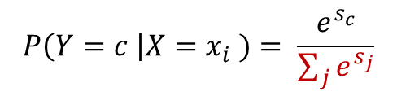
Example – softmax classifier
So far, we don’t have interpretation for the outputs of the score function
What if we would like to determine the probability of each class?
Softmax function
S $=f(x_{i}, W)$
$$P\left(Y=c \right|X=x_{i} )= \frac{e^{s_{c}}}{\sum_{j}{e^{s_{j}}}}$$
normalize

Slide 43
Example – softmax classifier
So far, we don’t have interpretation for the outputs of the score function
What if we would like to determine the probability of each class?
Softmax function
S $=f(x_{i}, W)$
$$P\left(Y=c \right|X=x_{i} )= \frac{e^{s_{c}}}{\sum_{j}{e^{s_{j}}}}$$
normalize

Slide 44
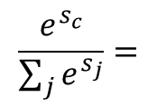
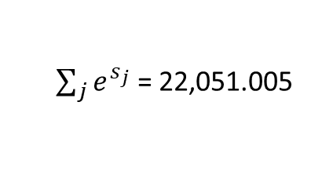
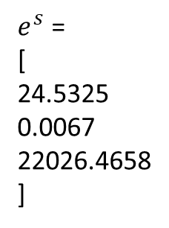
$$\frac{e^{s_{c}}}{\sum_{j}{e^{s_{j}}}}=$$
s =
[
3.2
-5
10
]
$e^{s}$ =
[
24.5325
0.0067
22026.4658
]
[
0.0011125
0.0000003
0.9988872
]
softmax function
$\sum_{j}{e^{s_{j}}}$ = 22,051.005
softmax function
hardmax function, one hot encoding
[
0.0011125
0.0000003
0.9988872
]
[
0
0
1
]
vs

Slide 45
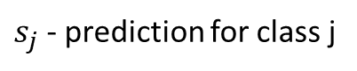



$$L_{i}=−\sum_{j=0}^{C}{y_{j}\log\left(s_{j}\right)}$$
$s_{j}$ - prediction for class j
Intuition:
The loss $L_{i}$ = $− log⁡(s_{c})$ should be as small as possible
→ the correct probability class should be as big as possible
$={ − y}_{c}\log\left(s_{c}\right)$
$$=− log⁡(s_{c})$$

Slide 46


$$L_{i}=−\sum_{j=1}^{C}{y_{j}\log\left(s_{j}\right)}$$
$s_{j}$ - prediction for class j
Intuition:
The loss $L_{i}$ = $− log⁡(s_{c})$ should be as small as possible
→ the correct probability class should be as big as possible
This loss function just looks at the correct class from the ground truth and tries to make the predicted probability of that class as big as possible
$={ − y}_{c}\log\left(s_{c}\right)$
$$=− log⁡(s_{c})$$

Slide 47



$$L_{i}=−log⁡(s_{c})$$
$$L=\frac{1}{N}\sum_{i}^{N}{L_{i} }$$
What is the minimum and maximum value of $L_{i}$?

Slide 48

$$L_{i}=−log⁡(s_{c})$$
$$L=\frac{1}{N}\sum_{i}^{N}{L_{i} }$$
What is the minimum and maximum value of $L_{i}$?
Min 0
Max infinity

Slide 49

$$L_{i}=−log⁡(s_{c})$$
$$L=\frac{1}{N}\sum_{i}^{N}{L_{i} }$$
What is the minimum and maximum value of the $L_{i}$?
Min 0
Max infinity
At initialization, when all the predicted scores will be approximately equal, what is the value of $L_{i}$?

Slide 50

$$L_{i}=−log⁡(s_{c})$$
$$L=\frac{1}{N}\sum_{i}^{N}{L_{i} }$$
What is the minimum and maximum value of $L_{i}$?
Min 0
Max infinity
At initialization, when all the predicted scores will be approximately equal, what is the value of $L_{i}$?
-log(1/C) = log (C)

Slide 51
Optimization
How can we find the best value for W?

Slide 52


Gradient descent
Follow the slope!

Slide 53

Follow the slope
In 1D the derivative of a function is:
Slope of the “line”
$$f^{′}(x)= \frac{∂f(x)}{∂x}= \lim_{h →0}{ }\frac{f\left(x+h\right) −f(x)}{h}$$

Slide 54

Follow the slope
Image source: https://medium.com/analytics-vidhya/stochastic-gradient-descent-1ab661fabf89

Slide 55
Gradient descent
while True: W_gradient = compute_gradient(loss_func, data, W) # update parameters W += -lr*W_gradient

Slide 56
Mini-batch gradient descent
Gradient descent is infeasible to compute if we have a large dataset
Update the weights using a mini-batch of examples
Common sizes for the batch: 32, 64, 128
while True:
batch = sample_batch(data) W_gradient = compute_gradient(loss_func, batch, W) # update parameters W += -lr*W_gradient

Slide 57
Evaluating a model’s performance

Slide 58

"Facts are stubborn things, but statistics are more pliable. " – Mark Twain
"There are three kinds of lies: lies, damned lies, and statistics. " – popularized by Mark Twain
Mark Twain

Slide 59
Evaluation metrics
True positives (TP)
False positives (FP)
True negatives (TN)
False negatives (FN)
Accuracy: The percent of predictions that the model got right
$$ACC=\frac{TP+TN}{TP+TN+FP+FN}$$

Slide 60

Evaluation metrics
True positives (TP)
False positives (FP)
True negatives (TN)
False negatives (FN)
Accuracy: The percent of predictions that the model got right
Accuracy will yield misleading results if the data set is unbalanced!!!
$$AC=\frac{TP+TN}{TP+TN+FP+FN}$$

Slide 61

The boy who cried wolf
https://developers.google.com/machine-learning/crash-course/classification/true-false-positive-negative

Slide 62

Confusion matrix
Image source: https://en.wikipedia.org/wiki/Confusion_matrix

Slide 63







Classification metrics
The relevance of TP, FP, TN, FN will depend on the purpose of the classifier and motivate the choice of metric
$$ac= \frac{TP+TN}{TP+TN+FP+FN}$$
$$rc=sn= \frac{TP}{TP+FN}$$
$$pr= \frac{TP}{TP+FP}$$
observations that do not contribute to the corresponding metric are struck through with a red line
$$F_{β}={\left(1+β^{2} \right)}^{ } \frac{pr⋅rc}{β^{2}⋅pr+rc}$$
$$MCC=φ= \frac{TP⋅TN −FP⋅FN}{\sqrt{(TP+FP)(TP+FN)(TN+FP)(TN+FN)}}$$
$$F_{1}=2 \frac{pr⋅rc}{pr +rc}= \frac{2 TP }{2TP+FP+FN}$$
https://www.nature.com/articles/nmeth.3945

Slide 64
Precision vs. recall
Precision: spam detection, predict when to launch a satellite, pregnancy tests etc.
Recall: airport security (make sure that every suspicions event is investigated), cancer prediction, detecting credit card frauds etc.

Slide 65

Precision, Recall, F1 score
Accuracy
The percent of prediction that the model got right
Precision
The ability of a model to identity only relevant instances
Recall
The ability of a model to identify all relevant instances
F1 score
Harmonic mean between precision and recall
$$F_{1}=2\frac{precision ∗recall}{precision+recall}$$

Slide 66



Precision vs. recall
Precision: 0.88
Recall: 0.64
FPR: 0.05
Precision: 0.8
Recall: 0.73
FPR: 0.105
Precision: 0.75
Recall: 0.82
FPR: 0.157
https://developers.google.com/machine-learning/crash-course/classification/precision-and-recall

Slide 67



Receiver Operating characteristic curve ROC curve
Shows the performance of a classifier at different classification thresholds
False Positive Rate (1- specificity) – x axis
True Positive Rate (sensitivity) – y axis
TPR
$$TPR= \frac{TP}{TP+FP}$$
$$FPR= \frac{FP}{FP+TN}$$
FPR

Slide 68

Receiver Operating characteristic curve ROC curve
https://towardsdatascience.com/roc-curve-and-auc-from-scratch-in-numpy-visualized-2612bb9459ab

Slide 69

Receiver Operating characteristic curve ROC curve
https://towardsdatascience.com/roc-curve-and-auc-from-scratch-in-numpy-visualized-2612bb9459ab

Slide 70

Receiver Operating characteristic curve ROC curve
https://towardsdatascience.com/roc-curve-and-auc-from-scratch-in-numpy-visualized-2612bb9459ab

Slide 71

Receiver Operating characteristic curve ROC curve
Shows the performance of a classifier at different classification thresholds
$$TPR= \frac{TP}{TP+FP}$$
$$FPR= \frac{FP}{FP+TN}$$

Slide 72


Area under the curve AUC
Measures the entire two-dimensional area underneath the entire ROC curve
Makes it easier to compare one ROC curve to another one

Slide 73
Recommended resources
Loss functions (Andrew Ng`s great explanations):
https://www.youtube.com/watch?v=LLux1SW--oM
https://www.youtube.com/watch?v=ueO_Ph0Pyqk
www.coursera.org – Deep Learning specialization: Neural Networks and Deep Learning (week 1 and 2)
https://cs231n.github.io/linear-classify/#intro

